Slide 1
DECISION TREES

Slide 2
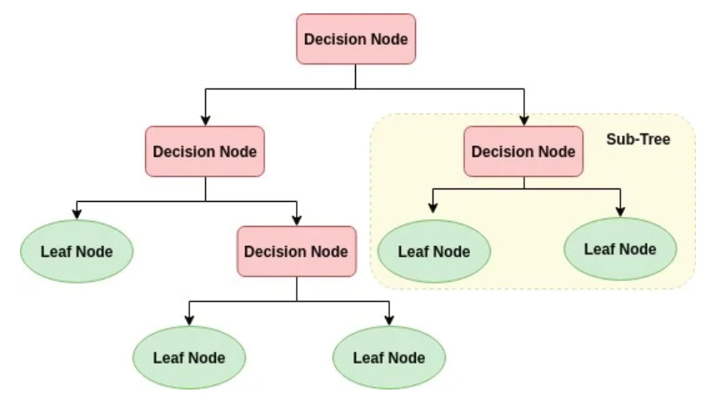
https://www.datacamp.com/community/tutorials/decision-tree-classification-python

Slide 3
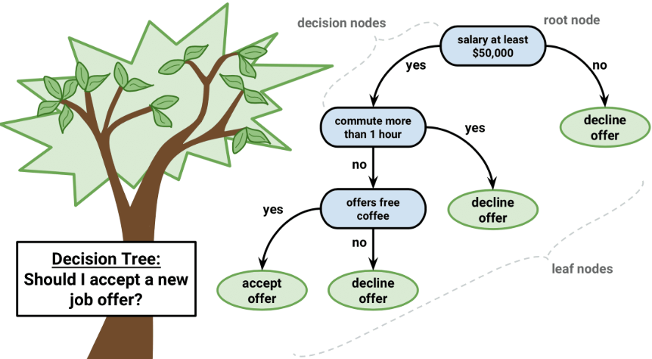
https://www.google.com/url?sa=i&source=images&cd=&ved=2ahUKEwjtu_6kqrXhAhUXFjQIHbJwBAIQjhx6BAgBEAM&url=http%3A%2F%2Fdataaspirant.com%2F2017%2F01%2F30%2Fhow-decision-tree-algorithm-works%2F&psig=AOvVaw2yOMf3WTEWc_MISPMvqj8q&ust=1554429188899119

Slide 4
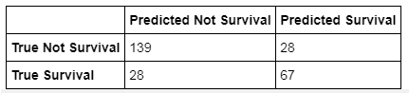
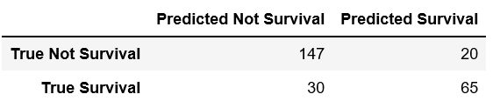
Logistic Regression Decision Tree
TN | FP
FN | TP
True Positives (TP) – number of positive examples, labeled as positive
False Positives (FP) – number of negative examples, labeled as positive
True Negative (TN) – number of negative examples, labeled as negative
False Negative (FN) – number of positive examples, labeled as negative

